Slide 1
Task 1
Name : Piyush Kumar E-mail: piyushkumar610990@gmail.com Contact no.: 7667517759
Internship Studio’s Ethical Hacking Internship

Slide 2
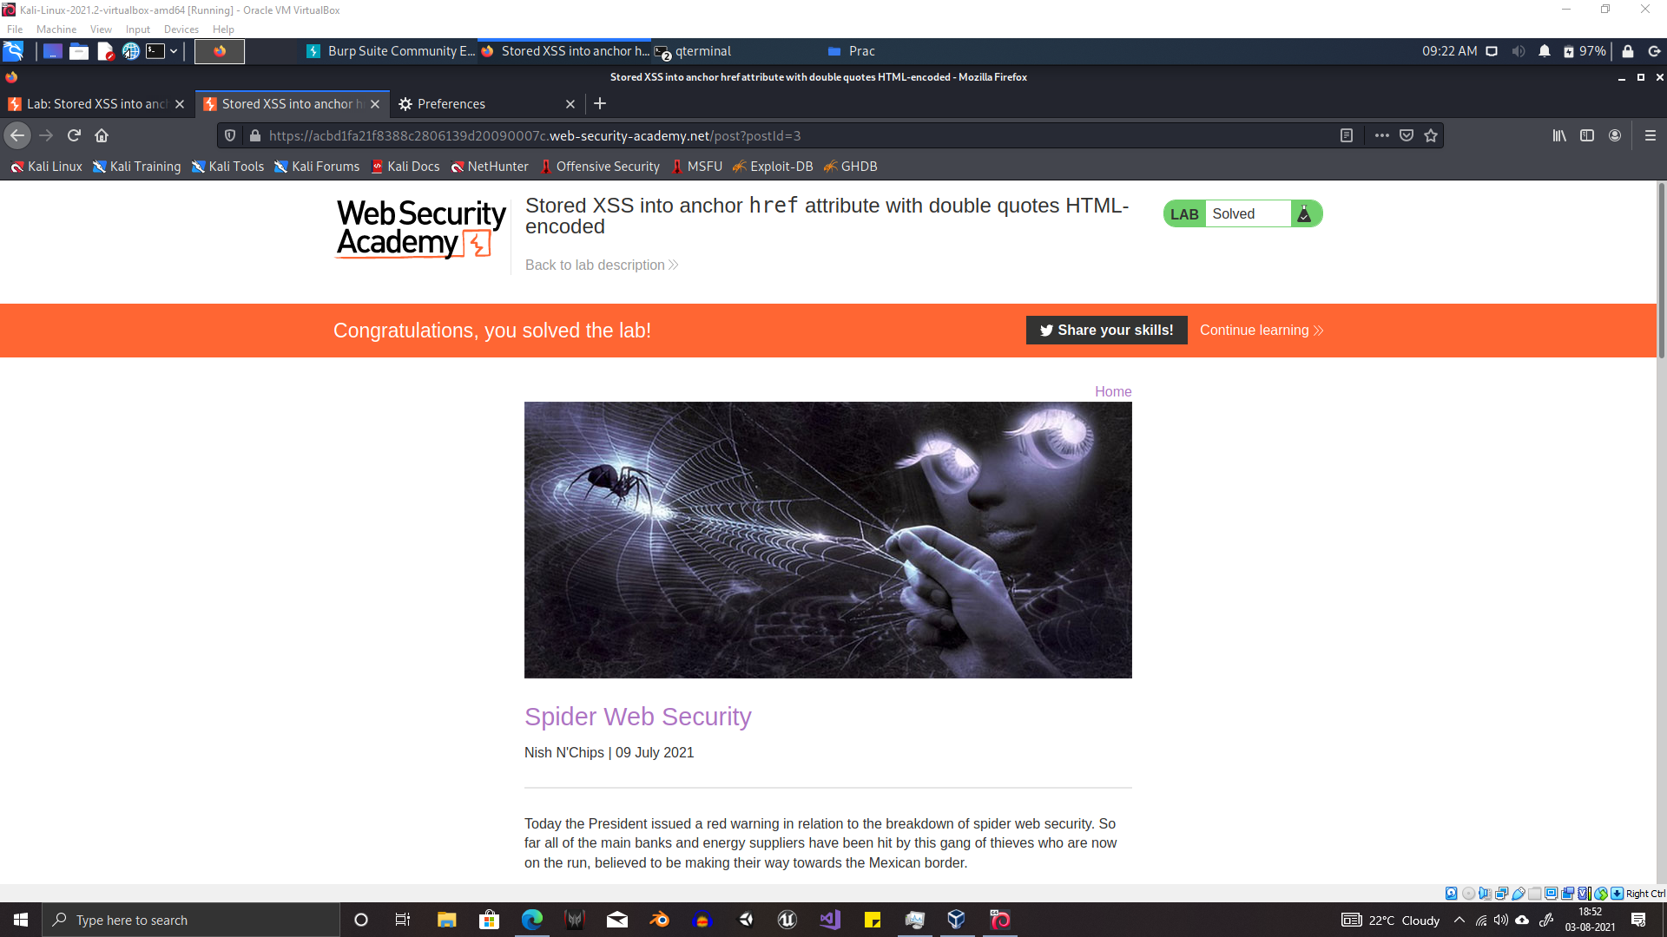

Slide 3
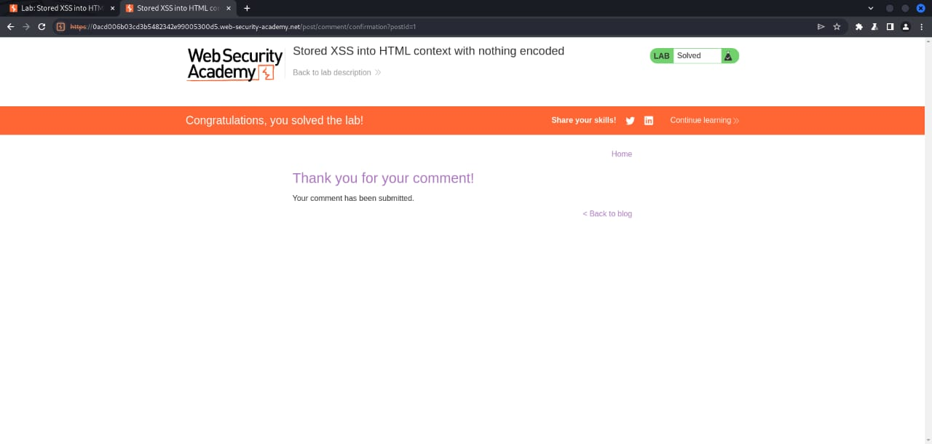

Slide 4
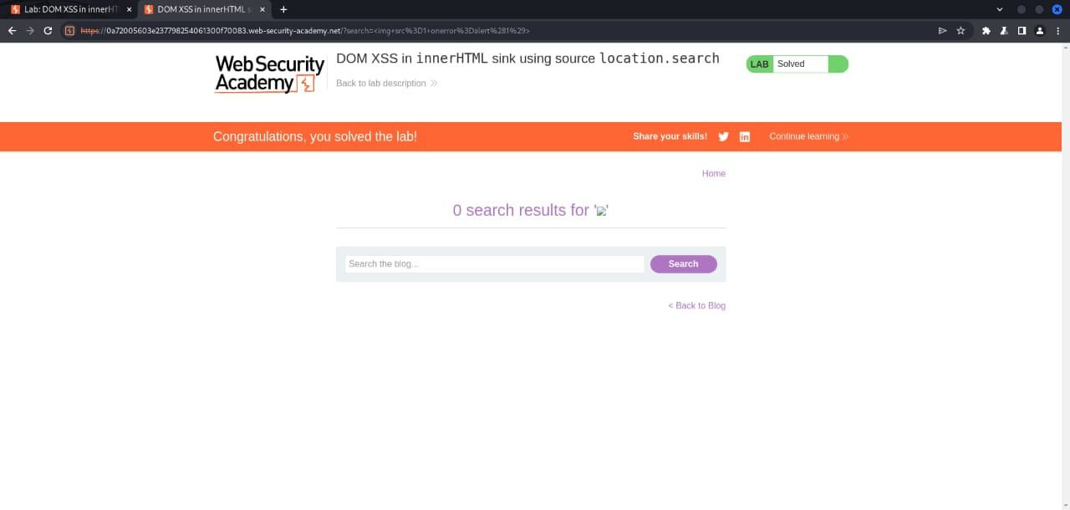

Slide 5
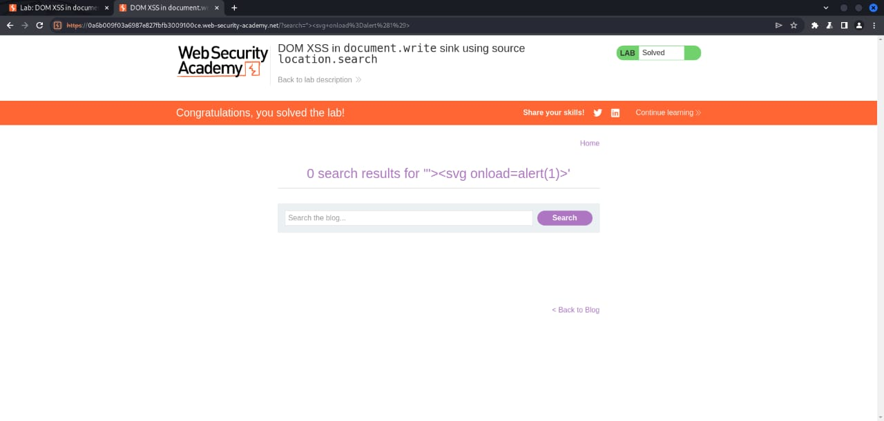

Slide 6
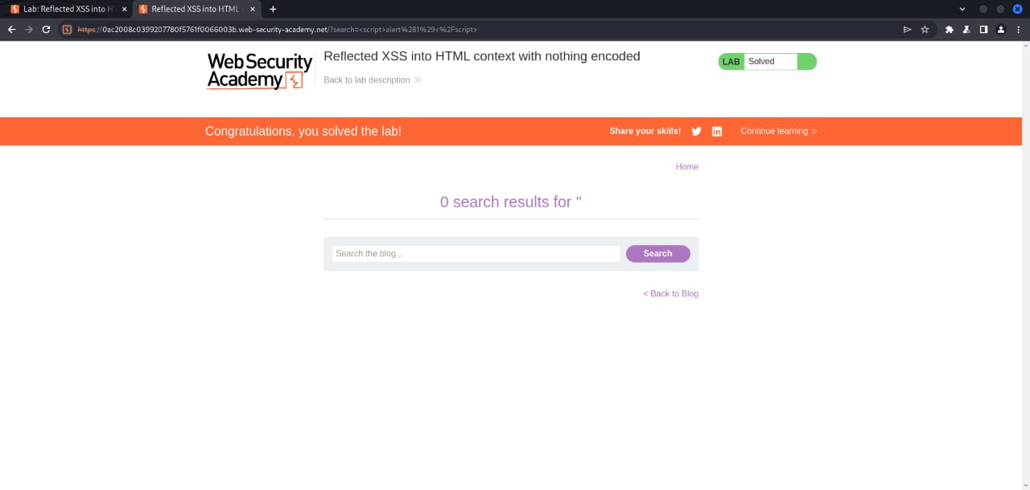

Slide 7


Thank You

